Slide 1
The Financial Behavior of Crypto Currencies A Quantitative Perspective
Daniele Marazzina

Slide 2
What are the main reasons for investing in cryptocurrencies? According to websites/literature…
01
02
03
Portfolio
Diversification
Hedging Against the Traditional System
High Return
Potential
Speculation
Decentralization
Accessibility and Transferability

Slide 3
Diversification
01

Slide 4
Portfolio Diversification
Cryptocurrencies, particularly Bitcoin, are considered by some studies to be uncorrelated or weakly correlated with traditional assets such as stocks, bonds, and commodities.
This characteristic makes them potentially useful tools for improving portfolio diversification and reducing overall risk
Hedging Against the Traditional System
Some investors view cryptocurrencies as an alternative to the traditional financial system. In periods of economic instability or distrust in fiat currencies, cryptocurrencies can be seen as an alternative "safe haven."
Is it true?

Slide 5
Cryptocurrencies and stock markets are dependent during crisis periods, but not during non-crisis periods.
This is evident after the Covid-19 epidemic. Pre-Covid: statistical tests agreed with the zero-correlation hypothesis.
Correlation is a statistical measure that describes the degree to which two variables move in relation to each other. It quantifies the strength and direction of the linear relationship between two variables. Positive Correlation: Both variables move in the same direction.
Zero Correlation: No predictable relationship between the variables.
Notes:
Prima del Covid, correlazione fra crypto e mercato nulla. Dopo il Covid, positiva

Slide 6
Diversification High Return Potential
01
02

Slide 7
High Return Potential
Cryptocurrencies have historically shown high volatility but also significant return potential. This attracts investors willing to take on higher risks in exchange for potentially higher rewards compared to traditional investments.
However, it is important to note that high returns are often accompanied by higher risks.

Slide 8
The portfolio frontier, also known as the efficient frontier, is a fundamental concept in modern portfolio theory introduced by Harry Markowitz.
It represents the set of optimal portfolios that offer the highest expected return for a given level of risk, or equivalently, the lowest risk for a given level of expected return.
Investing in S&P500, Bitcoin, Ether
Start | 15/11/2022
End | 15/11/2024
 | sp500 | btc | eth
Mean | 1.000772 | 1.003723 | 1.002372
V=VarCov Matrix | 0.000068 | 0.000071 | 0.000089 | sp500
 | 0.000071 | 0.001011 | 0.000957 | btc
 | 0.000089 | 0.000957 | 0.001269 | eth
correlation |  | 0.27 | 0.30
 |  |  | 0.84
Start | 15/11/2019
End | 15/11/2024
R | 1.0008 | 1.001 | 1.0015 | 1.002 | 1.003
w | 1.01 | 0.97 | 0.85 | 0.74 | 0.51
 | 0.03 | 0.13 | 0.36 | 0.60 | 1.07
 | -0.05 | -0.09 | -0.22 | -0.34 | -0.58
 | sp500 | btc | eth
Mean | 1.000571 | 1.002706 | 1.003440
V=VarCov Matrix | 0.000173 | 0.000200 | 0.000232 | sp500
 | 0.000200 | 0.001670 | 0.001572 | btc
 | 0.000232 | 0.001572 | 0.002497 | eth
correlation |  | 0.37 | 0.35
 |  |  | 0.77
R | 1.0008 | 1.001 | 1.0015 | 1.002 | 1.003
w | 0.90 | 0.83 | 0.63 | 0.44 | 0.05
 | 0.06 | 0.09 | 0.17 | 0.25 | 0.42
 | 0.03 | 0.08 | 0.19 | 0.31 | 0.54
Daily Return
1.0001 with certainty corresponds to +2.53% in a year
1.001 with certainty corresponds to +28.39% in a year
1.003 with certainty corresponds to +111.46% in a year
Notes:
Cripto con rendimento atteso più elevato del mercato, ma varianza molto più elevata. In un ipotetico portafoglio SP500, Bitcon, Ether, la presenza di criptovalute aumenta all’aumentare del rendimento atteso, ma diventa preponderante solo se si cercano rendimenti attesi «eccessivi»

Slide 9
Expected return of BTC-USD and ETH-USD are higher than SP500
Variance (and therefore risk) is higher for BTC-USD and ETH-USD
Positive (and high) correlation between BTC-USD and ETH-USD
Invest in ETH-USD, or short-sell (if possible) to invest in BTC-USD?
Should cryptocurrency always be recommended as an investment?
 | sp500 | btc | eth
Mean | 1.000571 | 1.002706 | 1.003440
V=VarCov Matrix | 0.000173 | 0.000200 | 0.000232 | sp500
 | 0.000200 | 0.001670 | 0.001572 | btc
 | 0.000232 | 0.001572 | 0.002497 | eth
correlation |  | 0.37 | 0.35
 |  |  | 0.77

Slide 10
Investing in S&P500, FTSE100, Bitcoin
Start | 22/11/2022
End | 22/11/2024
R | 1.0004 | 1.0005 | 1.0008 | 1.001 | 1.0015 | 1.002 | 1.003
w | 0.33 | 0.36 | 0.44 | 0.50 | 0.64 | 0.78 | 1.07
 | 0.68 | 0.62 | 0.47 | 0.37 | 0.12 | -0.14 | -0.65
 | 0.00 | 0.02 | 0.09 | 0.13 | 0.24 | 0.35 | 0.58
Daily Return
1.0004 with certainty corresponds to +10.60% in a year
1.0005 with certainty corresponds to +13.42% in a year
1.0008 with certainty corresponds to +22.33% in a year
1.001 with certainty corresponds to +28.39% in a year
1.003 with certainty corresponds to +111.46% in a year
Should cryptocurrency always be recommended as an investment?
Only if the goal is to pursue high profits while accepting significant risks.
Notes:
Cripto con rendimento atteso più elevato del mercato, ma varianza molto più elevata. In un ipotetico portafoglio SP500, Bitcon, Ether, la presenza di criptovalute aumenta all’aumentare del rendimento atteso, ma diventa preponderante solo se si cercano rendimenti attesi «eccessivi»

Slide 11
Speculation
02

Slide 12
Speculation
Many investors view cryptocurrencies as an opportunity to generate short-term profits due to their high volatility. In this context, buying and selling are primarily driven by price trends rather than economic fundamentals.
BTC-ETH Correlation – 4Y Rolling window
Notes:
L’elevata correlazione fra crypto rende difficile una diversificazione. Ma attenzione, il mercato non è solo fatto di csambi con valuta fiat

Slide 13
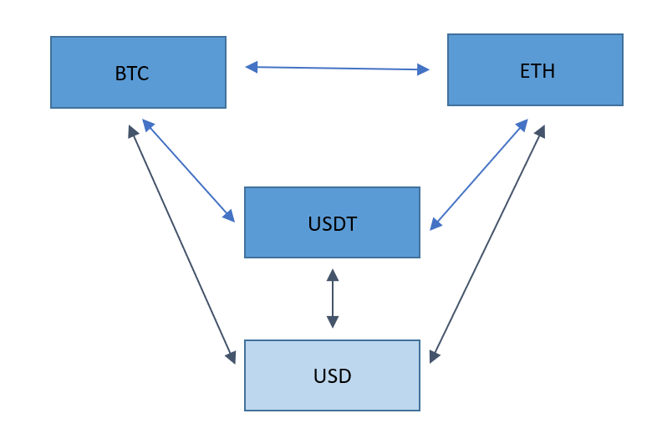
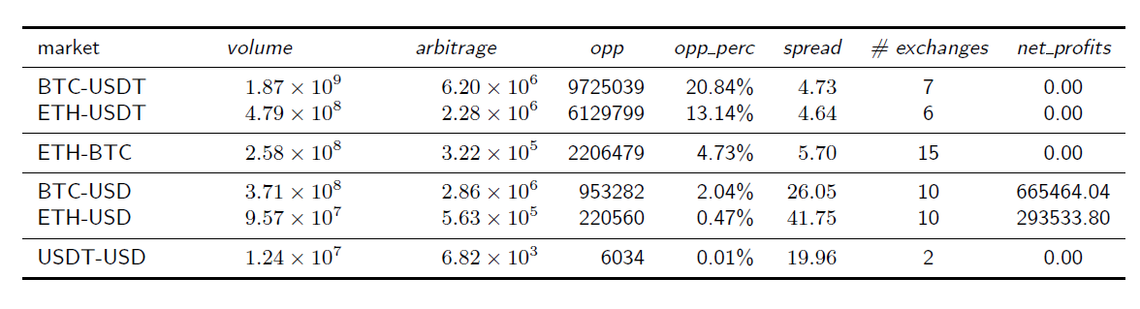
Arbitrage in cryptocurrency markets refers to the practice of exploiting price differences of the same cryptocurrency across multiple exchanges or markets to generate risk-free profits.
This strategy leverages the decentralized and fragmented nature of crypto markets, where prices can vary significantly due to liquidity, trading volume, and exchange-specific factors.
Notes:
I mercati Crypto VS Tether hanno maggiori opportunità di arbitraggi, ma con spread piccoli. I costi di transazione eliminano gli arbitraggi… I mercati col dollaro possono potenzialmente dare opportunità di arbitraggio maggiori

Slide 14
Decentralization Accessibility and Transferability
03

Slide 15
Decentralization
Cryptocurrencies are based on a decentralized system, meaning they are not controlled by a single entity like a central bank. This aspect can attract those seeking financial instruments outside of government or institutional control. [Unregulated Market, Market Manipulation]
Accessibility and Transferability
Cryptocurrencies offer direct access to global financial markets without the need for intermediaries, making them particularly attractive in contexts where the traditional banking system is less developed or less accessible. [Scalability problem]
The ability to transfer funds quickly and relatively cheaply across international borders is another reason for interest among some investors. [Crypto for illegal activities, frauds]

Slide 16
CRYPTOASSETS
AN OVERVIEW

Slide 17

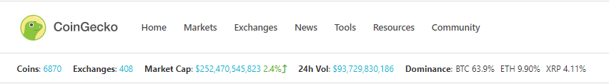
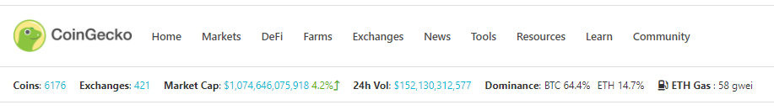
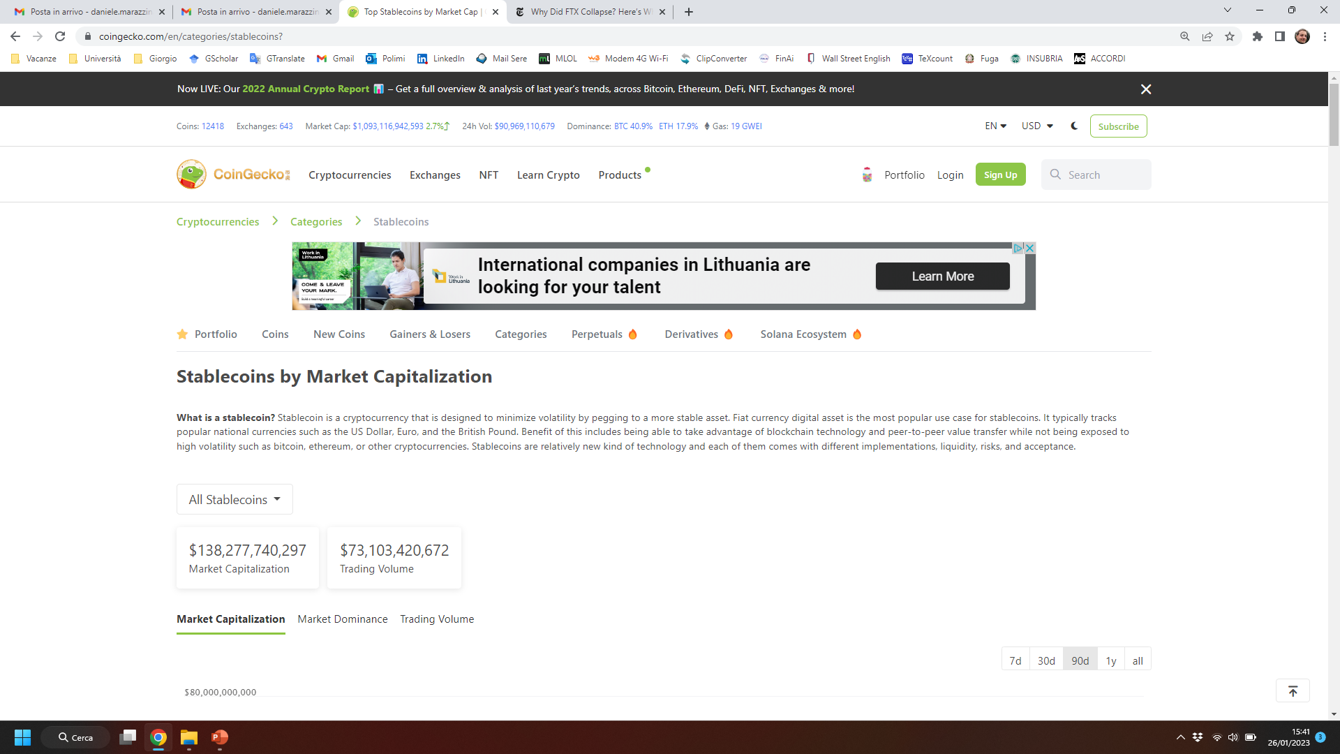
https://www.coingecko.com/
March 2, 2020
January 19, 2021
January 22, 2022
January 26, 2023
February 5, 2024
February 5, 2025

Slide 18
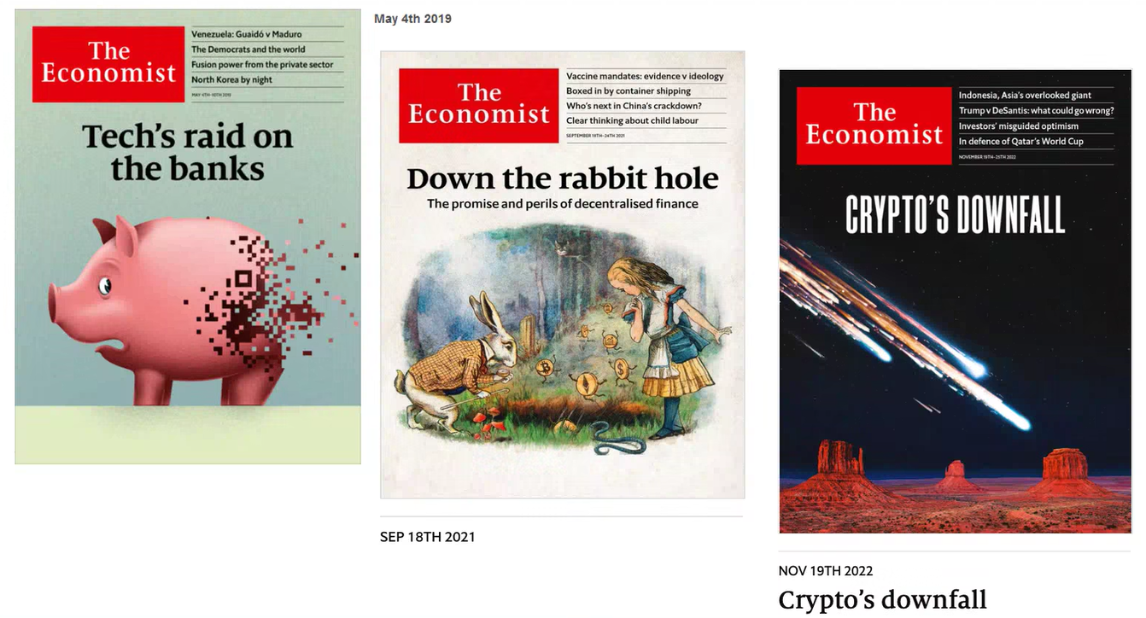

Slide 19
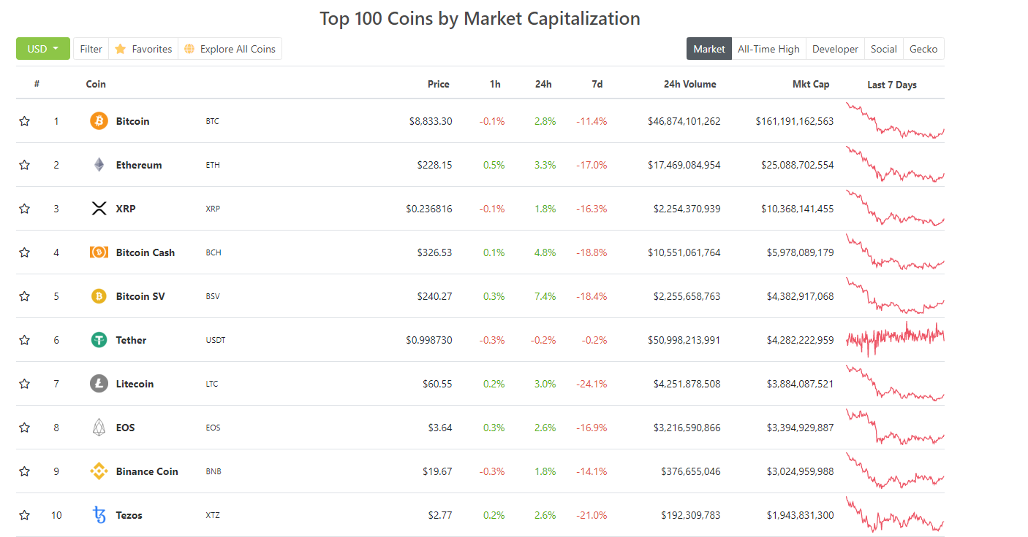
March 2020

Slide 20
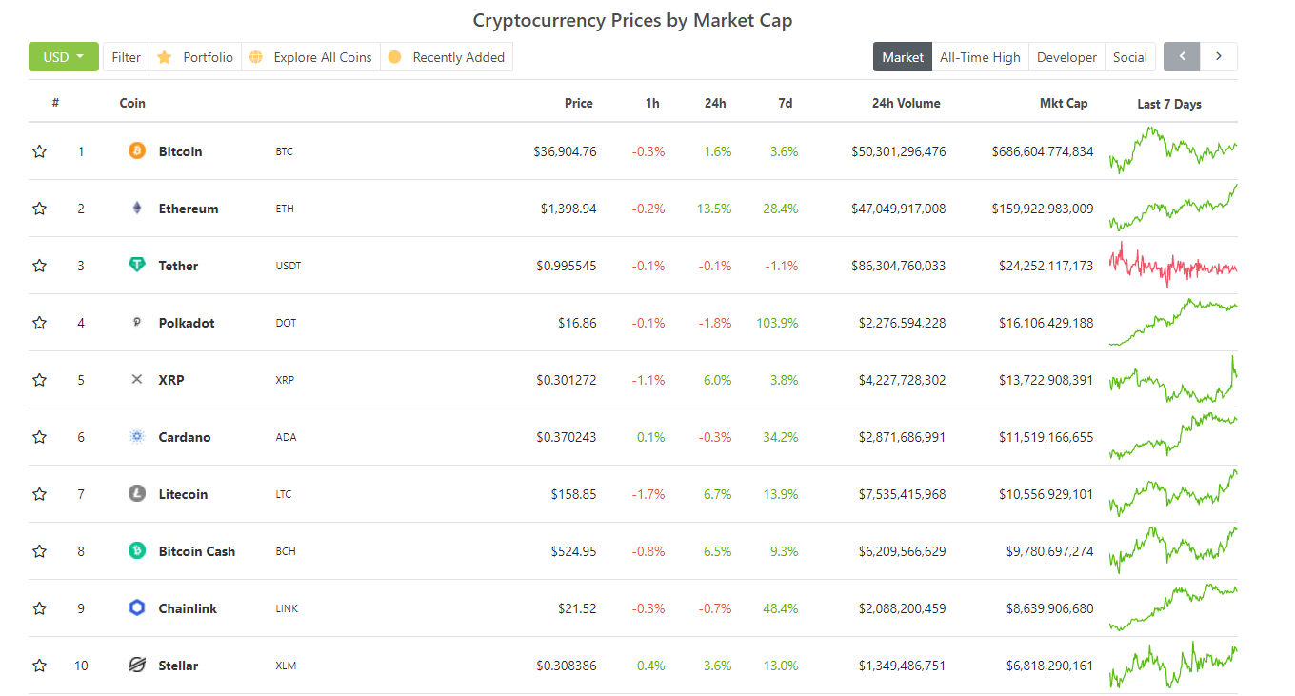
January 2021

Slide 21
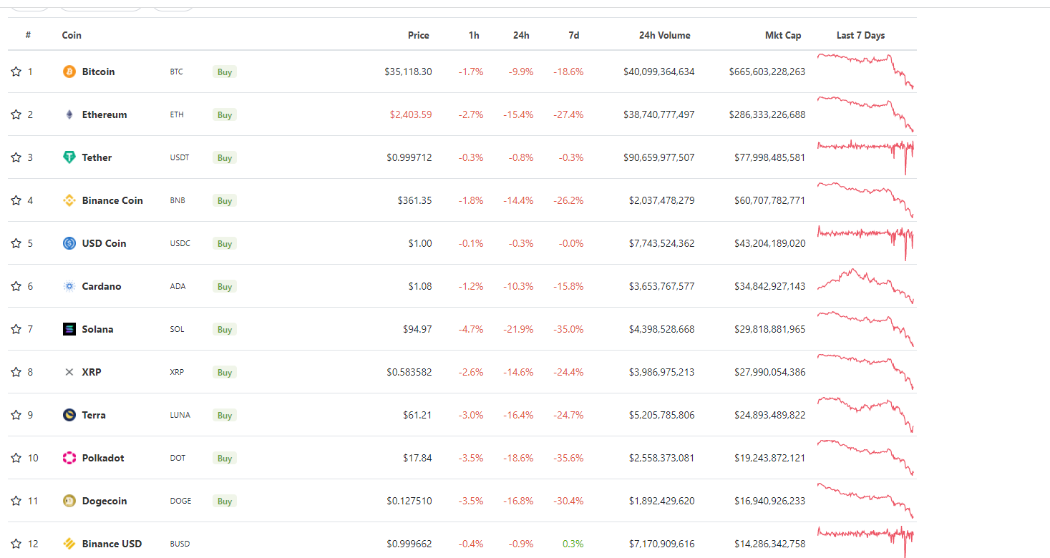
January 2022

Slide 22
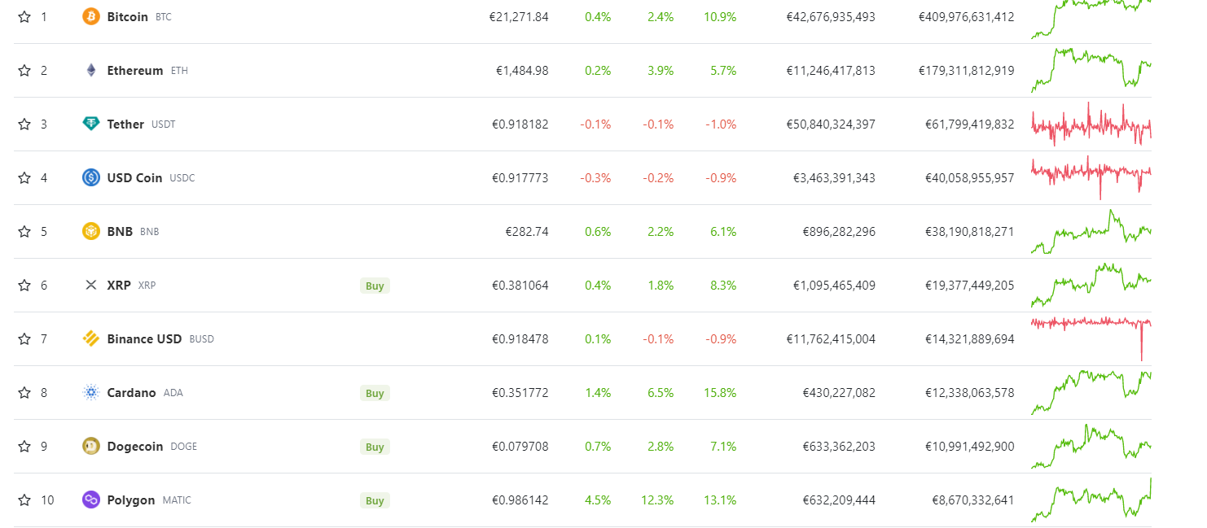
January 2023

Slide 23
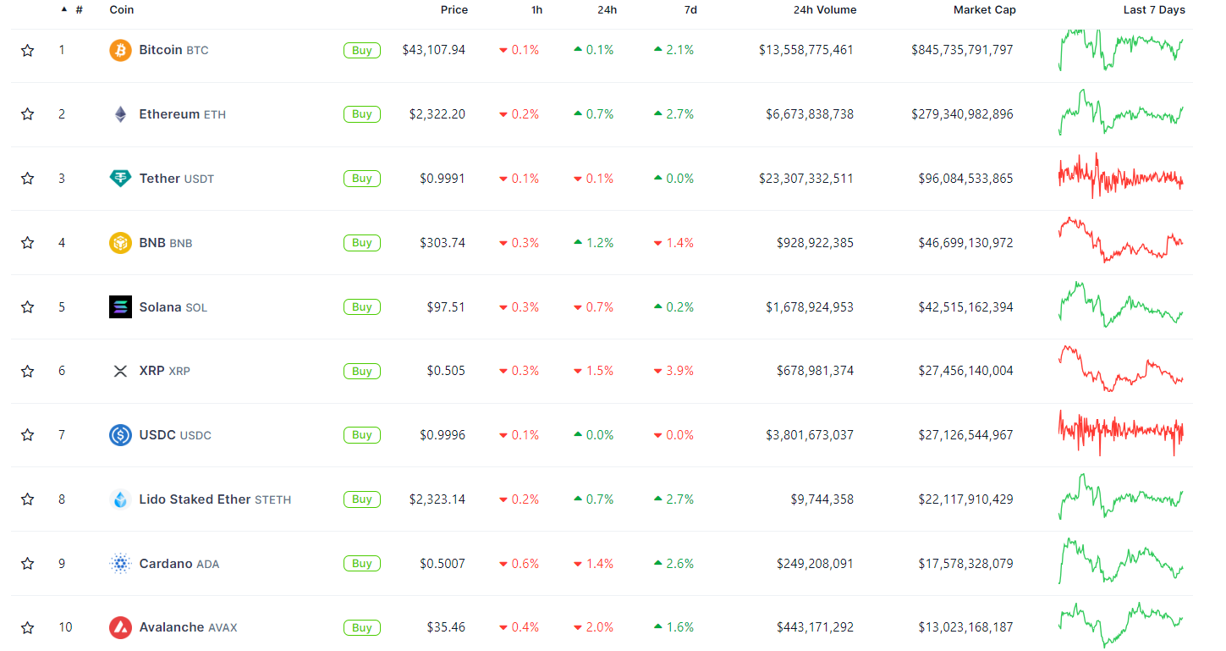
February 2023

Slide 24
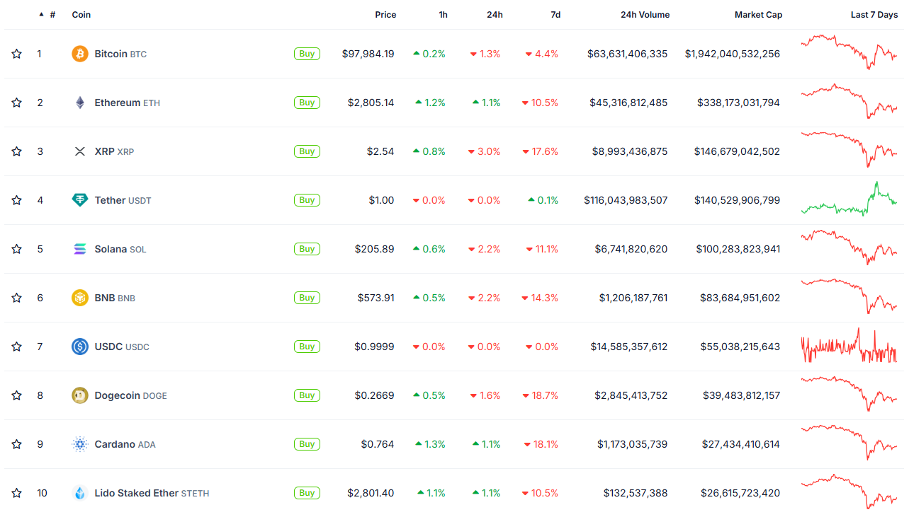
February 2024

Slide 25
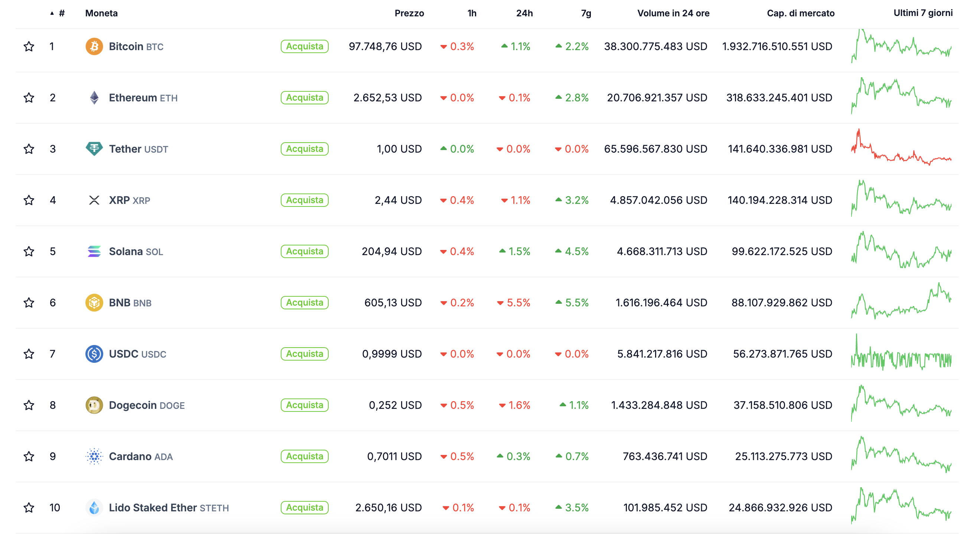
February 2025

Slide 26
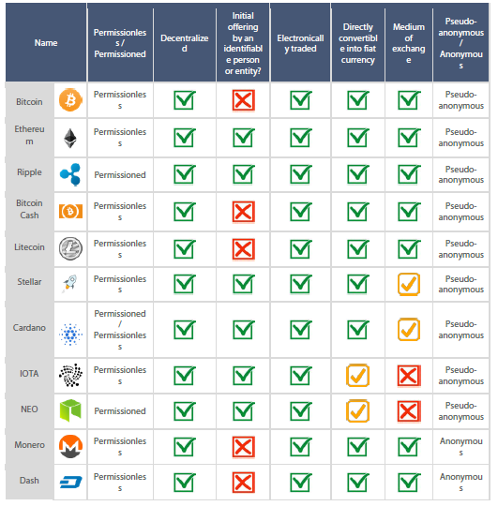
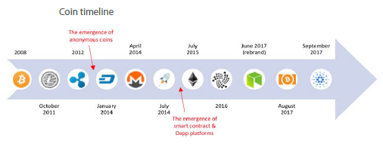

Slide 27
Source: https://www.coinbase.com/
XRP is the cryptocurrency used by the Ripple payment network. Built for enterprise use, XRP aims to be a fast, cost-efficient cryptocurrency for cross-border payments.
Bitcoin Cash is a fork of Bitcoin that seeks to add more transaction capacity to the network in order to be useful for everyday transactions.
Bitcoin SV is a fork of Bitcoin Cash (BCH). It attempts to restore the original Bitcoin protocol as defined by version 0.1 of Bitcoin.
Tether price (USDT) is a token that attempts to be tied to the US dollar. Ideally, this means that 1 USDT trades on exchanges at a value of exactly US $1.00.

Slide 28
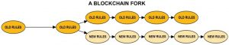
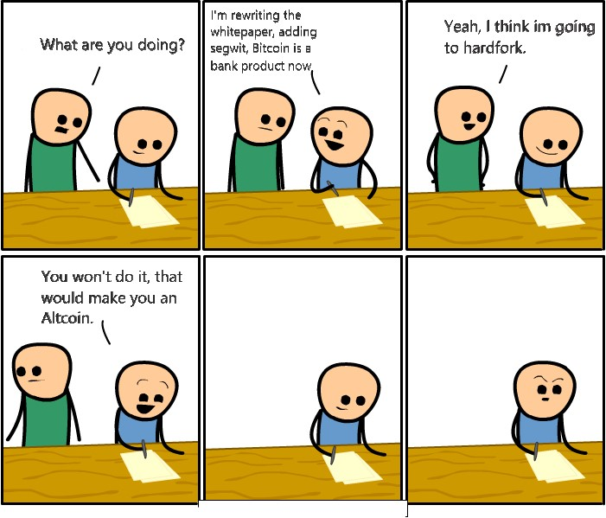
BITCOIN CASH AND BITCOIN SV: HARD FORK
A hard fork is a radical change to the protocol of a blockchain network
Altcoins are the other cryptocurrencies launched after the success of Bitcoin. Generally, they sell themselves as better alternatives to Bitcoin. The term "altcoins" refers to all cryptocurrencies other than Bitcoin.

Slide 29
Bitcoin Cash is a cryptocurrency that is a fork of Bitcoin. Bitcoin Cash is a spin-off or altcoin that was created in 2017. In 2018 Bitcoin Cash subsequently split into two cryptocurrencies: Bitcoin Cash, and Bitcoin SV.
FROM BITCOIN TO BITCOIN CASH
On 21 July 2017 bitcoin miners locked-in a software upgrade referred to as Bitcoin Improvement Proposal (BIP) 91: the Segregated Witness (Consensus layer)
SegWit alleviates the scaling problem enabling the Lightning Network, an overlay network of micropayment channels, hypothetically resolving the scaling problem by enabling virtually unlimited numbers of instant, low-fee transactions to occur "off chain“.
By 8 August 100% of the bitcoin mining pools signaled support for SegWit
A small group of mostly China-based bitcoin miners, that were unhappy with bitcoin's proposed SegWit improvement plans, pushed forward alternative plans for a split which created Bitcoin Cash. The proposed split included a plan to increase the number of transactions its ledger can process by increasing the block size limit.

Slide 30
FROM BITCOIN CASH TO BITCOIN SV
On 15 November 2018, a hard fork chain split of Bitcoin Cash occurred between two rival factions called Bitcoin Cash and Bitcoin SV.
The split originated from what was described as a "civil war" in two competing bitcoin cash camps.
The first camp promoted the software entitled Bitcoin ABC (short for Adjustable Blocksize Cap) which would maintain the block size at 32MB.
The second camp put forth a competing software version Bitcoin SV, short for "Bitcoin Satoshi Vision," that would increase the block size limit to 128MB.

Slide 31
What happens with a hard fork???
A hard fork refers to a split without backward compatibility with the previous blockchain. This involves a division of the two source codes and does not provide for data exchanges between the two blockchains.
So after a hard fork, there exists two different blockchains, which inherit the same “story”, i.e., all transactions before the fork.
Therefore, if one user had 1 BTC before the Bitcoin Cash fork, after the fork it had 1 BTC and 1 BCash
Usually the value of one of the two currencies experience a drop in value

Slide 32
Another hard fork of Bitcoin: Bitcoin Gold
Bitcoin Gold is a fork of Bitcoin that seeks to reduce the influence of miners who use specialized equipment known as ASICs. The team’s stated goal is to “make bitcoin decentralized again.”
Bitcoin Gold hard forked from the Bitcoin blockchain on October 24, 2017.
In May 2018, Bitcoin Gold was hit by a 51% hashing attack by an unknown actor. This type of attack makes it possible to manipulate the blockchain ledger on which transactions are recorded, and to spend the same digital coins more than once. During the attack, 388,000 BTG (worth approximately $18 million USD) was stolen from several cryptocurrency exchanges.
Bitcoin Gold suffered from 51% attacks again in January 2020.
https://thenextweb.com/hardfork/2020/01/27/bitcoin-gold-51-percent-attack-blockchain-reorg-cryptocurrency-binance-exchange/

Slide 33
The DAO
HARD FORK – The DAO
TheDAO, “Decentralized Autonomous Organization”
an automated investment fund, entirely managed by computers and based on blockchain technology: it had raised over 150 million dollars in the short period in which it was open to public subscription.
An individual or group of individuals found a flaw in the smart contract to steal funds from the "cash" of the TheDAO
The software platform was launched on May 28, 2016.
On Friday 17 June, funds were subtracted thanks to a "badly thought" line of code that allowed funds belonging to TheDAO to be subtracted.
If code-is-law, is this subtraction illegal?
If the blockchain is immutable, how can it be canceled?

Slide 34
Fork
A Soft Fork is an operation that updates Ethereum's functionality while maintaining backward compatibility.
A Hard Fork, on the other hand, is an update of the protocol that makes old versions of Ethereum obsolete.
"By 4pm local time, the consensus was that should a soft fork be deployed within 27 days, the attacker would not be able to retrieve the funds he had stashed into a child DAO.
A subsequent hard fork could even return all ether, including the DAO's 'extraBalance' and the stolen funds, back into a smart contract. That smart contract would contain a single function: withdraw().
This would make it possible for everyone who participated in the DAO to withdraw their funds: thanks to the support of the miners, and because nothing had been spent so far, nothing would be lost."

Slide 35
What happened?
A hard fork was made, the blockchain was rewritten by eliminating the transaction.
Like? With distributed consent! More than 50% of Ethereum users have accepted the update.
“The super majority of people (89%) voted for the Hard-Fork”
Distributed consent overcomes the immutability of the Blockchain
Hard Fork: Ethereum Classic

Slide 36
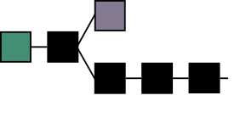
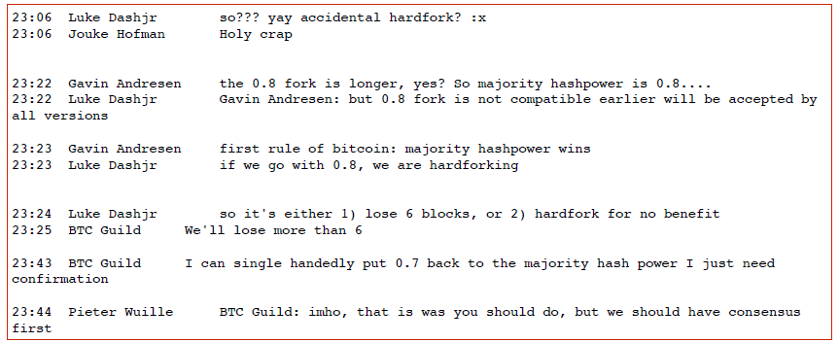
Hard fork occurs… even as error moving from 0.7 to 0.8 version of the software
BTC Guild (a mining pool) can decide on its own!
«longer chain rule» VS «50%+1» rule

Slide 37
RIPPLE
Within the Ripple system, money isn’t actually transferred from one place to another: only the promise of payment is transferred.
Ripple is a distributed, real-time payment protocol for anything of value. It’s a shared public database, with a built-in distributed currency exchange, that operates as the worlds first universal translator for money. Ripple is currency agnostic and has a foreign exchange component built right into the protocol. Ripple acts as a pathfinding algorithm to find the best route for a dollar to become a euro or airline miles to become Bitcoin. It will look at all the orders in the global order book. ANYBODY can put a bid-ask on anything of value. The Ripple protocol is designed to route every transaction to the cheapest price available in the market.
There is a transaction fee to use the exchange (~.00001XRP) and it must be paid in XRP, the native asset of the network. This transaction fee is not collected by anyone; the XRP is destroyed and ceases to exist.
Unlike Bitcoin, XRP transactions clear in 4 seconds or less.

Slide 38
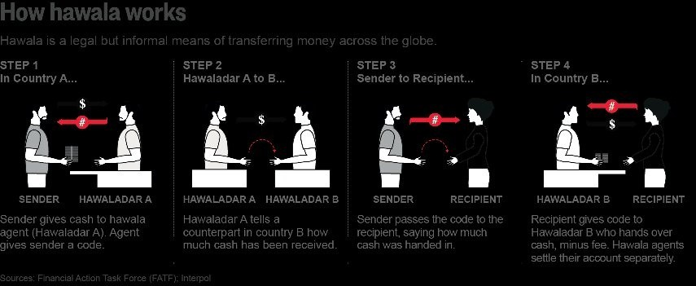
Hawala is a popular and informal value transfer system based not on the movement of cash, but on the performance and honour of a huge network of money brokers.

Slide 39
Rather than mining, Ripple works by consensus.
The Ripple system is a peer to peer system, in which participating devices all connect to the network. Some nodes just make and receive payments for their users while others operate as validators carrying out the consensus process. These validators “look” at the ledger, which is a snapshot of the current state of transactions on the network, and agree upon the current state utilizing the Ripple Protocol Consensus Algorithm (RPCA).
Prior to verification, validators take all the valid transactions it has seen that have not yet been applied to the current ledger and makes them public as a list known as the “candidate set”. Each validator then groups the candidate sets of all validators on its UNL (unique node list) and votes on the accuracy of all transactions. Transactions that receive more than a minimum percentage of “yes” votes are passed on to the next round while transactions that do not receive enough votes will either be discarded, or included in the candidate set for the beginning of the consensus process on the next ledger. The final round of consensus requires at least 80% of a validator UNL agreeing on a transaction. All transactions that meet this requirement are applied to the ledger.
Source:
https://medium.com/@haydentiff/what-is-ripple-efc179bc02ae
https://medium.com/@jcata018/everything-to-know-about-ripple-part-1-how-ripple-works-f7404aa4a8d1

Slide 40
A Cryptocurrency is a unit of value that is native to a blockchain. It is a means of exchange within the blockchain to incentivize the network of participants to use the blockchain. The cryptocurrencies Bitcoin, Ether, Ripple, and Litecoin are all examples of native cryptocurrencies. The sole purpose of a cryptocurrency is for exchange of value, and it has limited functionality beyond that.
A token is a piece of business logic (i.e., “smart contract”) coded into an existing blockchain. A token can have a functionality beyond an exchange of value — it can represent any asset or functionality desired by the developer for use on a platform. Most tokens are created on the Ethereum blockchain by using ERC-20 smart contracts.
Stablecoins are tokens

Slide 41
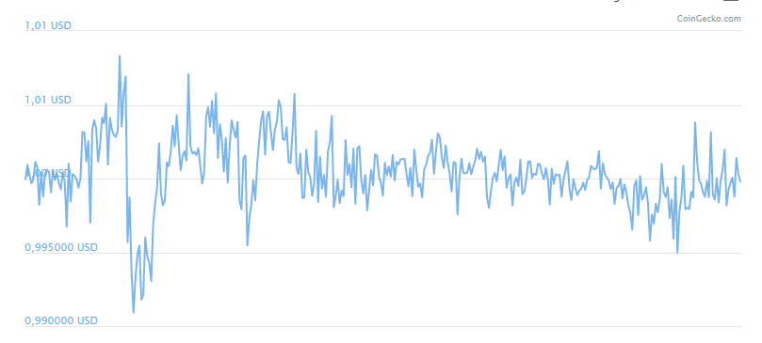
TETHER
Tether is called a stablecoin because it was originally designed to always be worth $1.00

Slide 42
STABLECOINS
April 2019 – October 2020
Let’s talk about
Stable Coin

Slide 43
CRYPTOASSETS
TOKEN

Slide 44
A Cryptocurrency is a unit of value that is native to a blockchain. It is a means of exchange within the blockchain to incentivize the network of participants to use the blockchain. The cryptocurrencies Bitcoin, Ether, Ripple, and Litecoin are all examples of native cryptocurrencies. The sole purpose of a cryptocurrency is for exchange of value, and it has limited functionality beyond that.
A token is a piece of business logic (i.e., “smart contract”) coded into an existing blockchain. A token can have a functionality beyond an exchange of value — it can represent any asset or functionality desired by the developer for use on a platform. Most tokens are created on the Ethereum blockchain by using ERC-20 smart contracts.

Slide 45
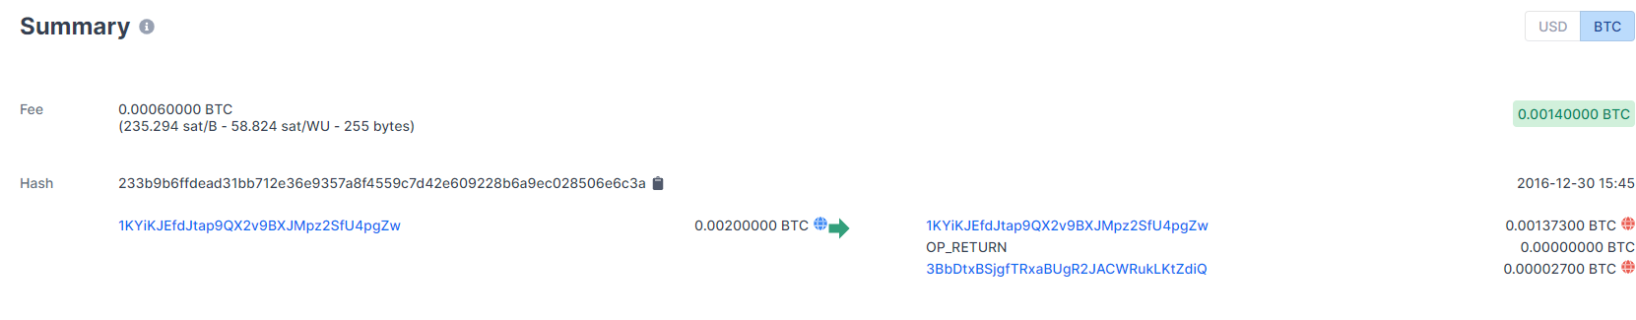
Transactions of tokens on omnichain
Every Omni transaction (e.g. Tether transaction) is recorded in a Bitcoin transaction sharing the same transaction hash. For example, this BTC transaction is actually the sending of 50,000 USDT .
https://www.blockchain.com/btc/tx/233b9b6ffdead31bb712e36e9357a8f4559c7d42e609228b6a9ec028506e6c3a
https://omniexplorer.info/address/3BbDtxBSjgfTRxaBUgR2JACWRukLKtZdiQ

Slide 46
https://blockstream.info/tx/233b9b6ffdead31bb712e36e9357a8f4559c7d42e609228b6a9ec028506e6c3a?expand
Let’s talk about
Smart Contract
Token
Ico

Slide 47
CRYPTOCURRENCIES
A QUANTITATIVE ANALYSIS

Slide 48
January 1, 2018 – February 1, 2022
BTC-USD
ETH-USD
BNB-USD
XRP-USD
Correlation
1.0000 0.8037 0.5841 0.5634
0.8037 1.0000 0.6449 0.5584
0.5841 0.6449 1.0000 0.4501
0.5634 0.5584 0.4501 1.0000

Slide 50
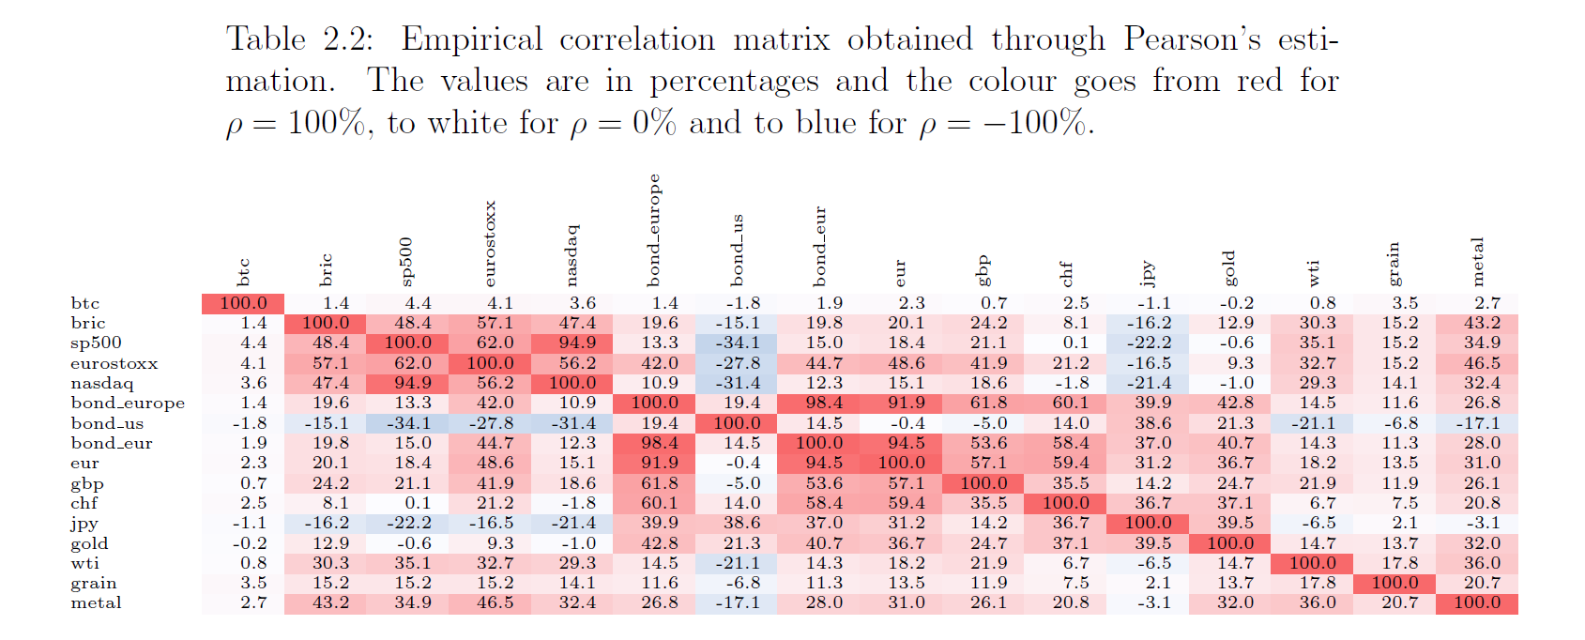
2010-2018

Slide 51
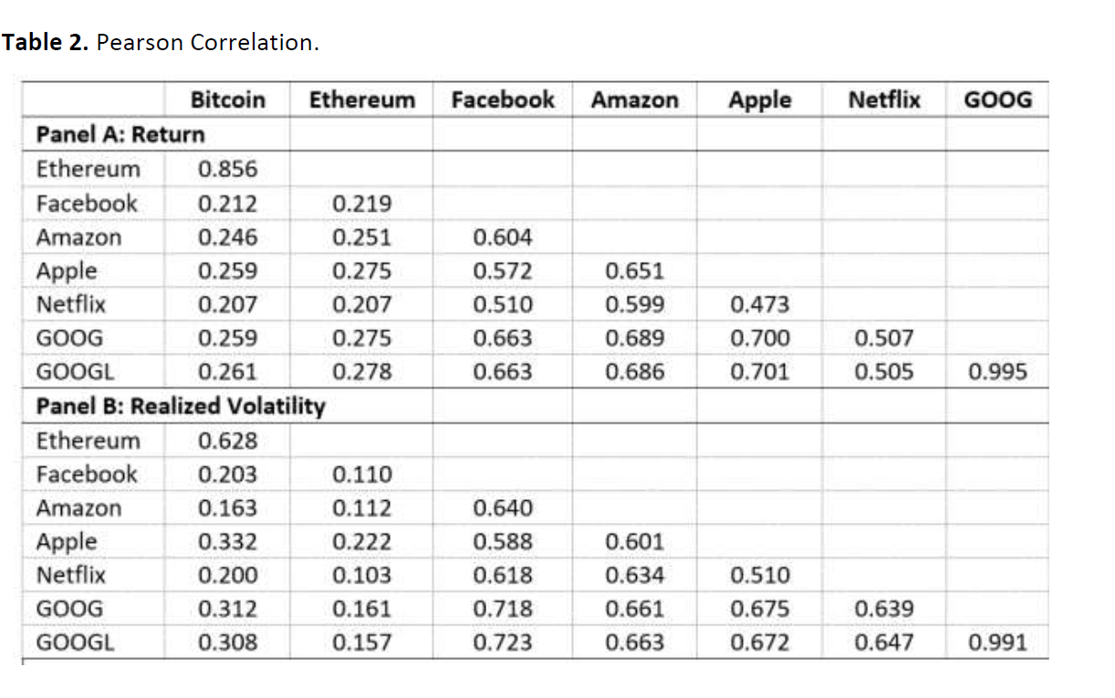
2018-2023

Slide 52
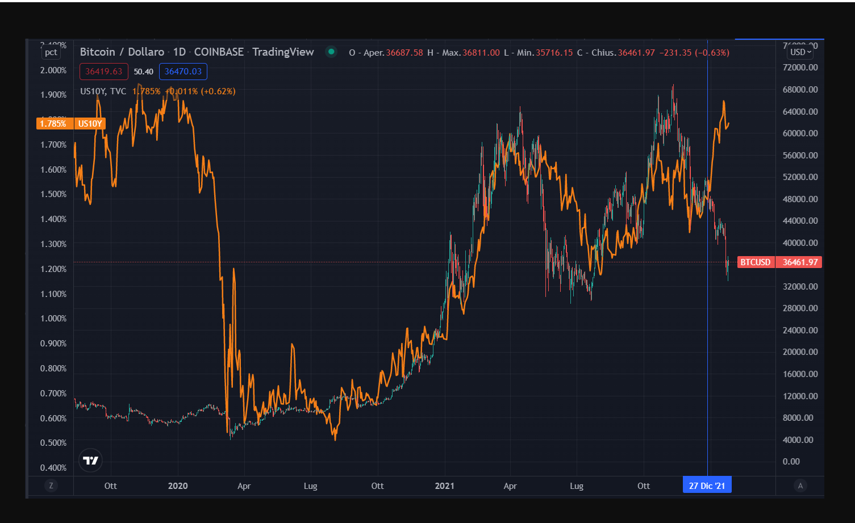

Slide 53
Three-years rolling correlation, from 2014 (t=0) to 2024 (t=10)
LogReturn of S&P500 and BTC-USD rate
Let’s talk about
Asset Allocation

Slide 54
DERIVATIVES

Slide 55
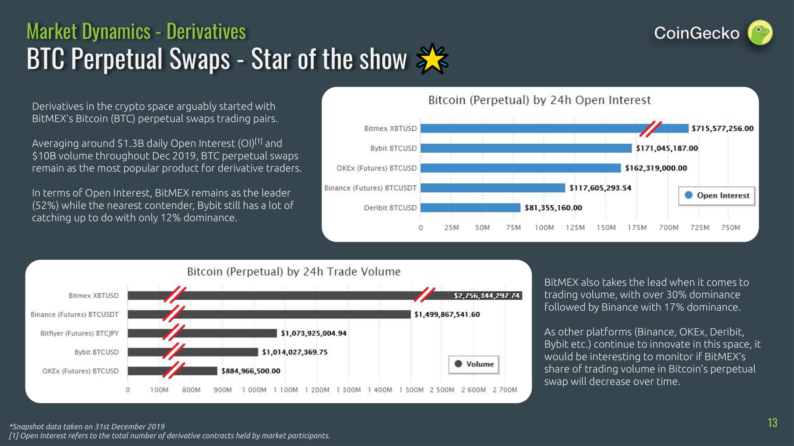
https://www.coingecko.com/en/derivatives/futures
https://www.coingecko.com/en/derivatives
Open interest is the total number of derivative contracts that have not been settled for an asset. Open interest provides a more accurate picture of the options trading activity, and whether money flows into the futures and options market are increasing or decreasing.

Slide 56
BTC Perpetual Swap
Perpetual contracts for Bitcoin, otherwise known as perpetual swaps, are an enormously popular type of futures contract largely dominated by the exchange BitMEX
Perpetual swaps are a form of futures contract for Bitcoin. A futures contract is an agreement between counter-parties to buy or sell an asset at an explicit price and date in the future. The buyer is obligated to buy the underlying asset a specific price once the contract expires, and the seller is required to furnish the asset at the time of expiry.
However, perpetual swaps are a unique form of futures contract called an “inverse futures contract.” This is similar to standard futures contracts, where cash-settlement of the asset can be accomplished without physical delivery. The difference is that with inverse futures for Bitcoin, settlement of a BTC/USD futures contract are in BTC, the base currency, instead of being settled in USD.
The USD is interpreted as the commodity in a standard futures market, while BTC represents the settlement of the contract (P/L).
In a Perpetual Contract
There is no expiry or settlement.
Perpetual Contracts are marked according to the Fair Price Marking method.
The primary mechanism is Funding: Periodic payments exchanged between the buyer and seller every 8 hours. If the rate is positive, then longs will pay and shorts will receive the rate, and vice versa if the rate is negative.

Slide 57
Marking and Settlement
As the BTCUSD contract is perpetual, there is no settlement. Marking for Unrealised PNL and Liquidation purposes are done according to the Fair Price Marking system.
Note also: since this product is a perpetual contract, funding occurs every 8 hours.
BTCUSD Trade Example
A trader goes long 100 BTC of BTCUSD at a price of 600 USD. He is long 100 BTC * 600 USD = 60,000 contracts. A few days later the price of the contract increases to 700 USD.
The trader’s profit will be: 60,000 * 1 * (1/600 - 1/700) = 14.286 BTC
If the price had in fact dropped to 500 USD, the trader’s loss would have been: 60,000 * 1 * (1/600 - 1/500) = -20 BTC. The loss is greater because of the inverse and non-linear nature of the contract. Conversely, if the trader was short then the trader’s profit would be greater if the price moved down than the loss if it moved up.

Slide 58
https://www.sec.gov/news/statement/gensler-statement-spot-bitcoin-011023
Jan. 10, 2024
Today, the Commission approved the listing and trading of a number of spot bitcoin exchange-traded product (ETP) shares.
I have often said that the Commission acts within the law and how the courts interpret the law. Beginning under Chair Jay Clayton in 2018 and through March 2023, the Commission disapproved more than 20 exchange rule filings for spot bitcoin ETPs. One of those filings, made by Grayscale, contemplated the conversion of the Grayscale Bitcoin Trust into an ETP.
We are now faced with a new set of filings similar to those we have disapproved in the past. Circumstances, however, have changed. The U.S. Court of Appeals for the District of Columbia held that the Commission failed to adequately explain its reasoning in disapproving the listing and trading of Grayscale’s proposed ETP (the Grayscale Order). The court therefore vacated the Grayscale Order and remanded the matter to the Commission. Based on these circumstances and those discussed more fully in the approval order, I feel the most sustainable path forward is to approve the listing and trading of these spot bitcoin ETP shares.

Slide 59
DECENTRALIZED FINANCE
Banking the Unbanked

Slide 60
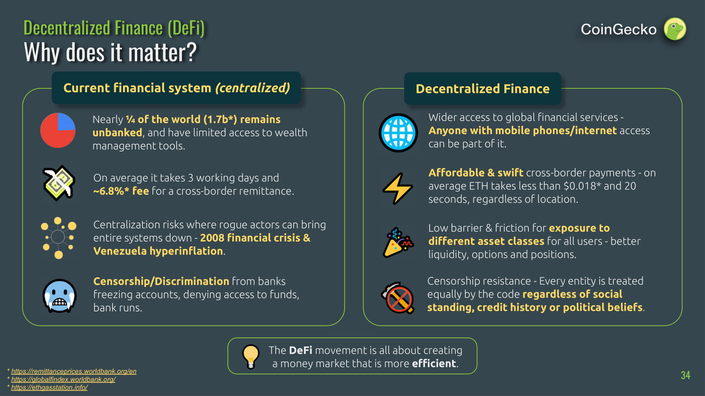

Slide 61
DeFi has become a trending topic in the blockchain community. In contrast to the decentralization of money through Bitcoin, DeFi aims for a broader approach of generally decentralizing the traditional financial industry. The core of the initiative is to open traditional financial services to everyone, in providing a permissionless financial service ecosystem based on blockchain infrastructure.
DeFi is an ambitious attempt to decentralize core traditional financial use cases like trading, lending, investment, wealth management, payment and insurance on the blockchain.
While it may be difficult to determine which blockchain protocols and applications will get the most usage long-term, currently the advanced decentralization, programmatic flexibility and the truly enthusiastic developer base gives Ethereum the lead.
For Ethereum, going forward, the fate of adoption of DeFi is tied to the scalability and usability of Ethereum.
DeFi has yet to prove it is a true improvement. Currently, the usability is unintuitive, risk-adjusted pricing is non-existent and the liquidity cannot compete with the centralized alternatives. Nevertheless, we are bullish that these are issues of a nascent ecosystem.
Source: https://medium.com/@philippsandner/decentralized-finance-defi-what-do-you-need-to-know-9cd5e8c2a48

Slide 62
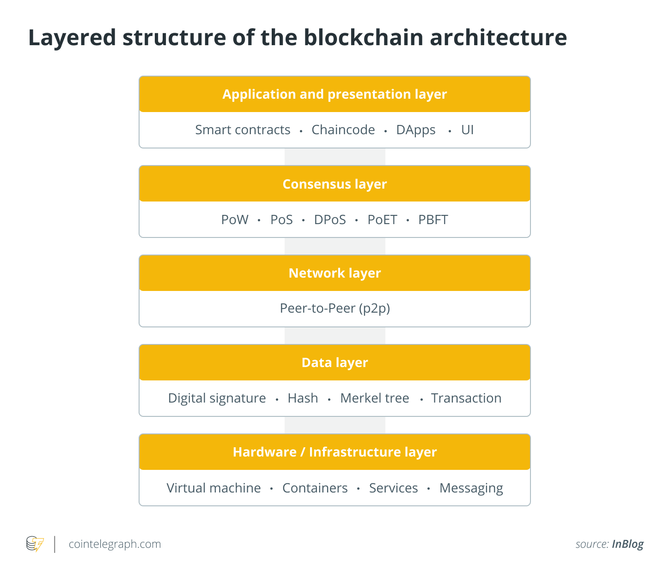
Blockchain Layers
Application layer
Smart contracts, chaincode and decentralized applications (DApps) make up the application layer.
Chaincode: while the terms "smart contract" and "chaincode" are often used interchangeably, "smart contracts" refers to the business logic that governs transactions and access to its data, while "chaincode" refers to the larger infrastructure of packages and other code that encompasses a smart contract.
DApps: they are essentially blockchain-based smart contract-powered versions of apps popularized by the Ethereum network. They act just like traditional apps — a user shouldn’t even notice a difference — but provide much more in terms of a feature set.

Slide 63
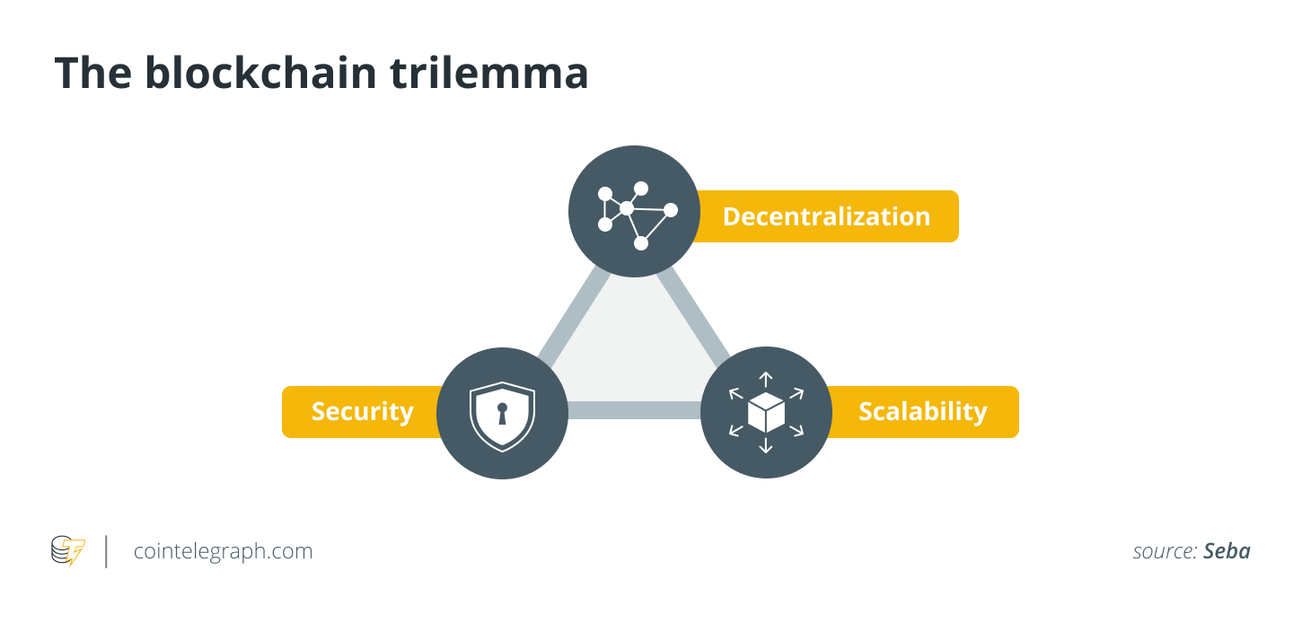
Blockchain Layers
Layer 0: Hardware/Infrastructure layer
Layer 1: Data layer, Network layer, Consensus layer… that is the Blockchain
Layer 2: Application and presentation layer
Why layer 2?

Slide 64
Layer one blockchain networks are designed for speed, security and expansion.
Layer two refers to technology enhancements and products that can be utilized to expand the scalability of existing blockchain networks.
Getting the perfect balance between the two layers might be a game-changer for blockchain adoption and the expansion of decentralized networks.
Developers are approaching the issue from a variety of perspectives. The increased block size in Bitcoin Cash was an attempt to improve Bitcoin's scalability. However, there is no evidence that it is becoming more popular.
Layer three… on blockchain interoperability → path to the future blockchain???

Slide 65
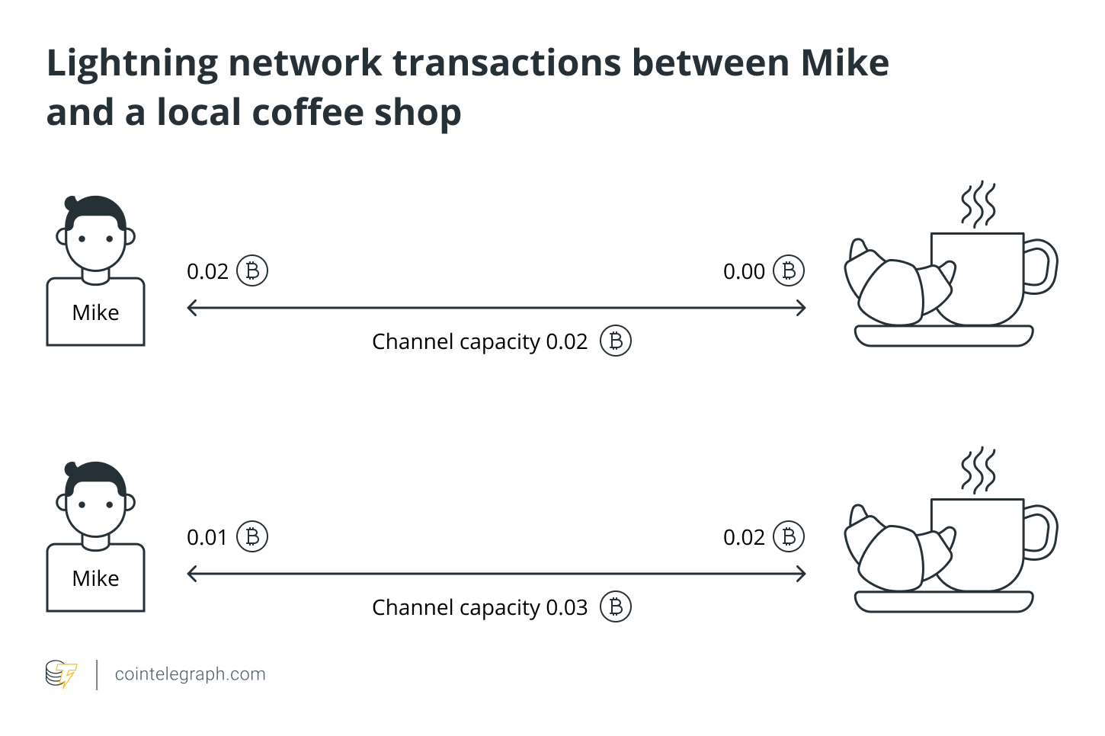
Bitcoin's Lightning Network is an example of a layer two blockchain.
The layer two solutions will bundle numerous transactions together and only query the base layer blockchain once in a while, according to the idea behind scaling solutions.
The protocol enables the creation of a peer-to-peer payment channel between two parties.
Once established, the channel allows the transacting parties to send an unlimited amount of transactions that are nearly instant and inexpensive.
To create a payment channel, the payer must lock a certain amount of Bitcoin onto the network. Once the Bitcoin is locked in, the recipient can invoice amounts of it as they see fit. If the customer wants to keep the channel open, they can choose to add Bitcoin consistently.
The two parties can transfer funds to each other indefinitely without informing the main blockchain. As all transactions on the layer-2 protocol do not need to be approved by all nodes, it substantially speeds up transactions.
Eventually, when the two parties decide to finish transacting, they can close the channel. All of the channel’s transactions are then consolidated into one transaction, which is sent to the Bitcoin mainnet to be recorded. Aggregating them into one transaction takes less time and effort for nodes to validate.

Slide 66
The Lightning Network is a "Layer 2" payment protocol that operates on top of a blockchain-based cryptocurrency (like Bitcoin).
It enables fast transactions among participating nodes and has been touted as a solution to the Bitcoin scalability problem.
It features a peer-to-peer system for making micropayments of cryptocurrency through a network of bidirectional payment channels without delegating custody of funds.
Normal use of the Lightning Network consists of opening a payment channel by committing a funding transaction to the relevant base blockchain (Layer 1), followed by making any number of Lightning transactions that update the tentative distribution of the channel's funds without broadcasting those to the blockchain, optionally followed by closing the payment channel by broadcasting the final version of the settlement transaction to distribute the channel's funds.
To perform as intended, Lightning Network required a transaction malleability fix in the Layer 1 blockchain, such as Segregated Witness (SegWit) in Bitcoin.
Transaction Malleability: it lets someone change the unique ID of a bitcoin transaction before it is confirmed on the bitcoin network.

Slide 67
TOKENS
FUNGIBLE and NON-FUNGIBLE

Slide 68
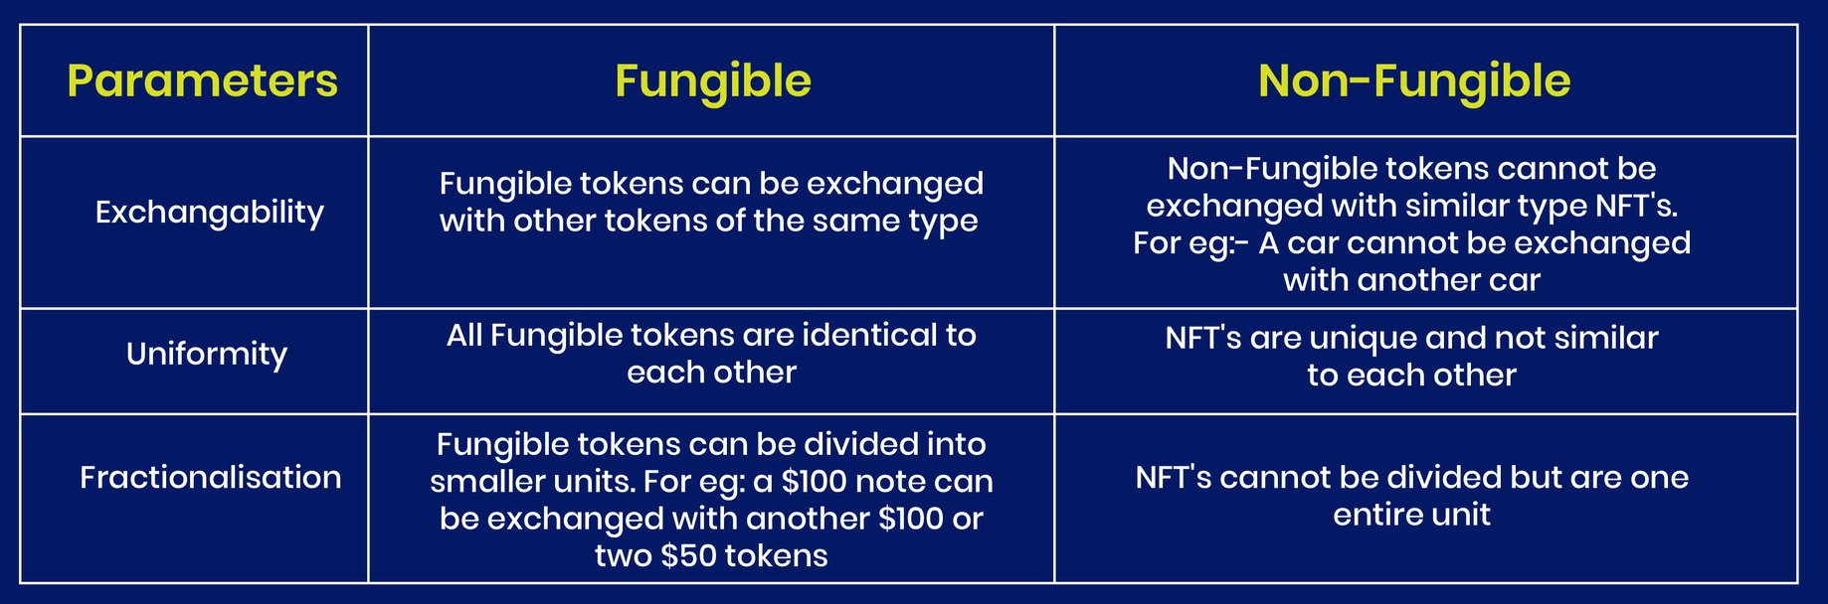

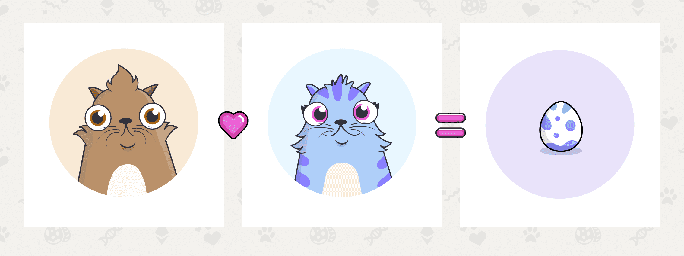
Fungible and Not Fungible Token

Slide 69
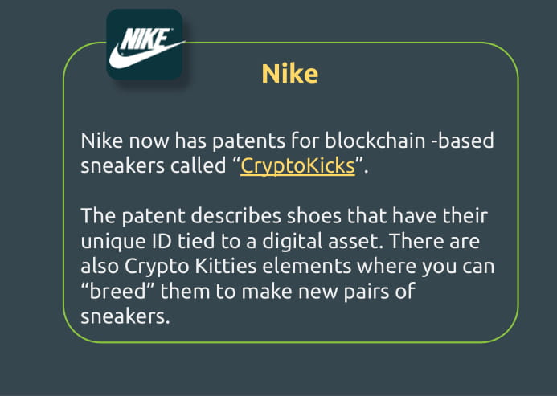
CryptoKicks @ Nike
When you buy a pair of the “CryptoKicks,” you’ll also receive a digital asset attached to a unique identifier of that shoe. As a result, there is digital scarcity of the digital assets, as their production is effectively tied to the production of real sneakers
When sneakers are sold to someone else, ownership can be transferred by trading both real shoe and/or associated digital assets. These digital assets can be stored in what’s being called a “Digital Locker,” a cryptocurrency wallet type app.

Slide 70
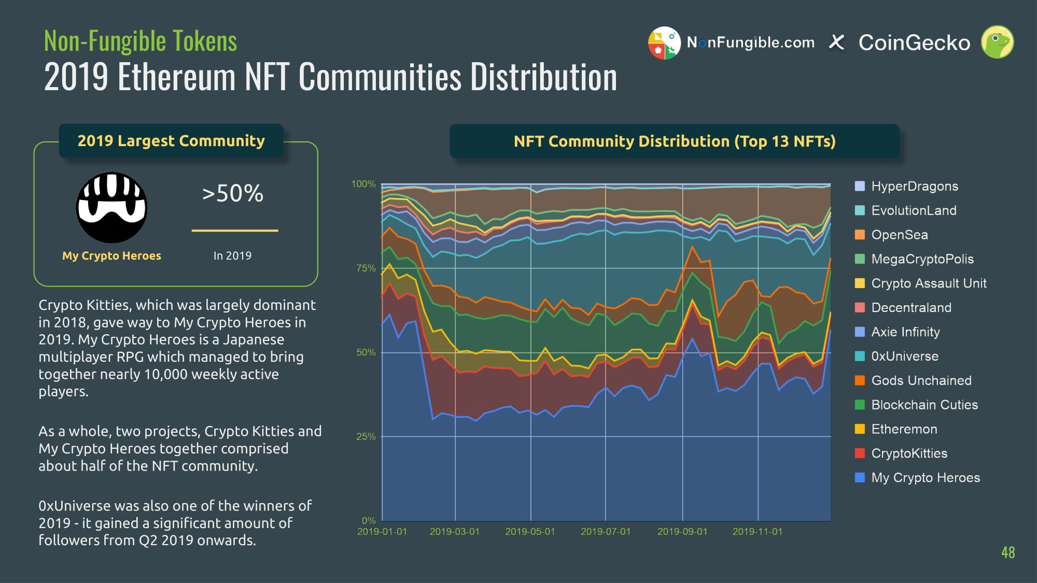

Slide 71
Cryptokitties
CryptoKitties is a blockchain game on Ethereum developed by Axiom Zen that allows players to purchase, collect, breed and sell virtual cats. It is one of the earliest attempts to deploy blockchain technology for recreation and leisure. The game's popularity in December 2017 congested the Ethereum network, causing it to reach an all-time high in number of transactions and slowing it down significantly.
CryptoKitties operates on Ethereum's underlying blockchain network, as a non-fungible token (NFT), unique to each CryptoKitty. Each CryptoKitty is unique and owned by the user, validated through the blockchain, and its value can appreciate or depreciate based on the market. CryptoKitties cannot be replicated and cannot be transferred without the user's permission even by the game developers. Users can interact with their CryptoKitties, having the ability to buy, sell, and sire (breed) them.
The virtual cats are breedable and carry a unique number and 256 bit distinct genome with DNA and different attributes (cattributes) that can be passed to offspring. Several traits can be passed down from the parents to the offspring. There are a total of 12 'cattributes' for any cat, including pattern, mouth shape, fur, eye shape'. Other features like cool down times are not passed down but are instead a function of the 'generation' of the offspring, which is one higher than the maximum generation between the two parents. In December 2017 a CryptoKitty sold for $100,000
A CryptoKitty's ownership is tracked via a smart contract on the Ethereum blockchain. Each CryptoKitty is represented as a non-fungible token using the ERC-721 token standard on Ethereum. Generation 0 CryptoKitties were sold to players in an auction at the rate of one every 15 minutes (672 per week) for one year. New CryptoKitties are created by breeding existing CryptoKitties. Based on the limited number of cats going into circulation and their limited genomes, there is a limit of around 4 billion total cats that can be bred.

Slide 72
CRYPTOASSETS
HOW TO CREATE

Slide 73
First, it’s important to understand the difference between coins and tokens.
Both are cryptocurrencies, but while a coin—Bitcoin, Ether—operates on its own blockchain, a token lives on top of an existing blockchain infrastructure like Ethereum.
Tokens are often released through a crowdsale known as an initial coin offering (ICO) in exchange for existing coins, which in turn fund projects like gaming platforms or digital wallets. You can still get publicly available tokens after an ICO has ended—similar to buying coins—using the underlying currency to make the purchase.
Etherscan, which provides Ethereum analytics, has more than 71,000 token contracts in its archive

Slide 74
So, how to create a crypto?
Build Your Own Blockchain—or Fork an Existing One - Both methods require quite a bit of technical knowledge. You can fork an existing blockchain by taking the open-source code found on Github making a few changes, and launching a new blockchain with a new name

Slide 75
So, how to create a crypto?
Launch a Coin or Token Using a Cryptocurrency Creation Platform - all you have to do is to choose a platform, pay for this service, and then enter the parameters, from the logo to the number of coins awarded for signing a block
You can also create a token—what is essentially a smart contract—with or without a public ICO. Because tokens can represent any asset, you can even create a token with no real value or serious purpose other than to exchange among friends. This is faster, simpler, and cheaper than creating a coin because it doesn’t require the time and effort to build and maintain a new or forked blockchain and instead relies on the technology already in use for Bitcoin or Ethereum.
Source: https://lifehacker.com/how-to-create-your-own-cryptocurrency-1825337462

Slide 76
And then…
You need to find someone which will buy the coin or token
Not easy… you need a community interested in your coin/token: usually it is easier if the coin/token is connected to a real project
Plenty of cryptocurrencies are unsuccessful, even questionable from a legal standpoint, because the ICO wasn’t created in good faith or the coin failed to generate lasting interest

Slide 77
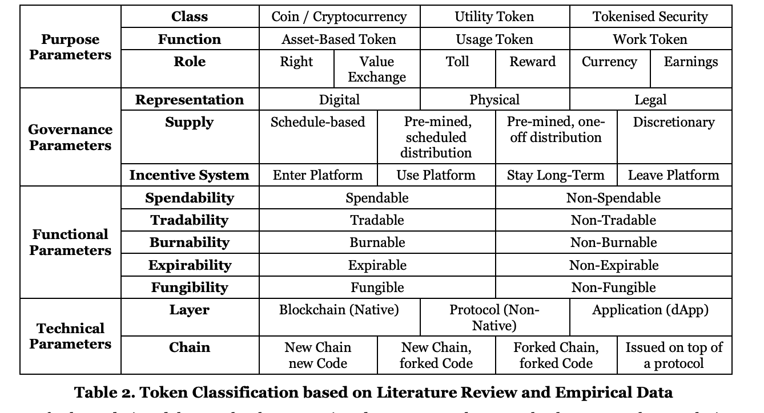
How to create a coin or token
Coin & Token are crypto assets
Coin = Cryptocurrency → native of a blockchain
Token → exploit a technology
Sometimes the word “Coin” is used for a general crypto asset (e.g., stable coins are token).

Slide 78
To create your own token:
Step 1: Deciding Which Business Problems Your Token Will Solve
If you want to create a token that will be successful in the market, you need to solve people’s real problems.
Step 2: Defining Your Audience
You have to understand why people would use your token, what problems they have, and how your token can solve those problems for them.
Step 3: Choosing a Token Name and Symbol
Choose a token name that is unique, catchy, and easy to remember. A good rule of thumb is not to use the same combination of words in your project’s name that are used by other projects and not out of crypto context.
Step 4: Choosing How Your Tokens Are Distributed
The distribution is how tokens will be distributed among investors and early adopters of your platform. You might decide to distribute them equally among early adopters through crowdfunding. You can also distribute them at certain times or after a certain time has passed. The best way to set up token supply is based on how much money was invested into the platform previously as part of an ICO or security token offering (STO).

Slide 79
Step 5: Choosing a Token Network
The network is what connects all the nodes and allows them to communicate. The two most common networks are the public Ethereum network, and private blockchains like Hyperledger Fabric.
Step 6: Choosing a Token Website
There’s no point in creating tokens if nobody knows about them.
How Much Does It Cost to Start a Crypto Token?
The cost of creating a cryptocurrency token depends on several factors, including the complexity of your project and what services you use for development. You’ll need to pay for legal services such as patenting and trademarking your idea or software. You may also need to hire experts in marketing who can help promote your product effectively and efficiently.
The costs involved in creating a token vary depending on who you choose to work with. Considering the average web 3.0 developer salary, the prices for token creation can range anywhere from $5,000 to over $100,000.

Slide 80
To create your own cryptocurrency, you need:
Design your blockchain architecture (you need to find the right developers);
Audit your new blockchain and its code (you need to hire a blockchain auditor for that);
Get legal advice (you need to look for a professional to be sure that your crypto complies with all relevant laws and regulations)
Or… (hard) fork an existing blockchain (with or without old transaction history)

Slide 81
How to create an NFT (they are token, see previous slides)
Decide what type of NFT you want to create. NFTs are versatile—you have plenty of options for choosing which type you want to create. ...
Choose an NFT marketplace. ...
Set up a crypto wallet. ...
Buy crypto through an exchange. ...
Connect your wallet to the NFT platform and mint.
Costs
Do you need a developer?
These platforms make it easier for new creators to dive into the world of NFTs. Some require you to authenticate or write your NFT on the blockchain (steps 3-5), while some allow for “shortcuts” like lazy minting. In lazy minting, you can avoid some fees by putting up your NFT for sale without writing it on the blockchain, then passing that fee to your buyer if it’s purchased. Some platforms requires a fee to initialize your account, which could cost up to $100 in some cases.
4-5. Blockchain fees, like ETH gas
Main difficulty
What is the reason why someone would like to buy your NFTs?
Minting an NFT is the process of publishing your NFT on the blockchain.
https://solsea.io/
https://rarible.com/
https://opensea.io/

Slide 82
EXCHANGE

Slide 83
How you can use an exchange platform
Use it, and ask to send your money to your wallet
Leave your money to the exchange… in this case…
pros
Easy and convenient for new users
Some exchanges provide users with tax forms, making it easier to calculate crypto taxes
cons
Vulnerable to hacking, fraud, or theft
If the exchange goes down, users can’t access their funds or place trades
Individuals who use the custodial exchange wallet do not hold their private keys

Slide 84
Different kind of exchange platforms
Centralized Exchanges https://www.coingecko.com/en/exchanges
These exchanges have a third party that helps conduct transactions to make sure they go through as intended — similar to a brokerage.
This might seem counterintuitive since one of the founding tenets of cryptocurrencies is that they are decentralized — meaning they aren’t issued or regulated by a government or other central authority. But a centralized cryptocurrency exchange can make it easier to buy your intended crypto with regular currency.
The potential risk inherent in some centralized exchanges is that these exchanges, being held by a single entity, are more vulnerable to an attack.
Decentralized Exchanges https://www.coingecko.com/en/exchanges/decentralized
A decentralized cryptocurrency exchange, or DEX, operates without the third party commonly used centralized exchanges. You could say decentralized exchanges are closer to the spirit of the cryptocurrency world because they are open source and depend on users to trade peer to peer.
In theory, a decentralized cryptocurrency exchange could be more secure than a centralized exchange. Because there’s no central entity or server to hack, it might make it harder to steal cryptocurrency. Fees might be lower and your transactions might also process faster in a DEX.
A DEX might have some drawbacks compared to their centralized counterparts. You might have to be a little more skilled with tech because a DEX may not offer the easy transfers from bank accounts or debit cards to buy crypto.
Some DEX don’t offer fiat currency changes at all and your only option might be to trade one cryptocurrency for another. Your funds aren’t insured and there’s nobody to call if you run into a customer service issue, as there’s no central authority.

Slide 85
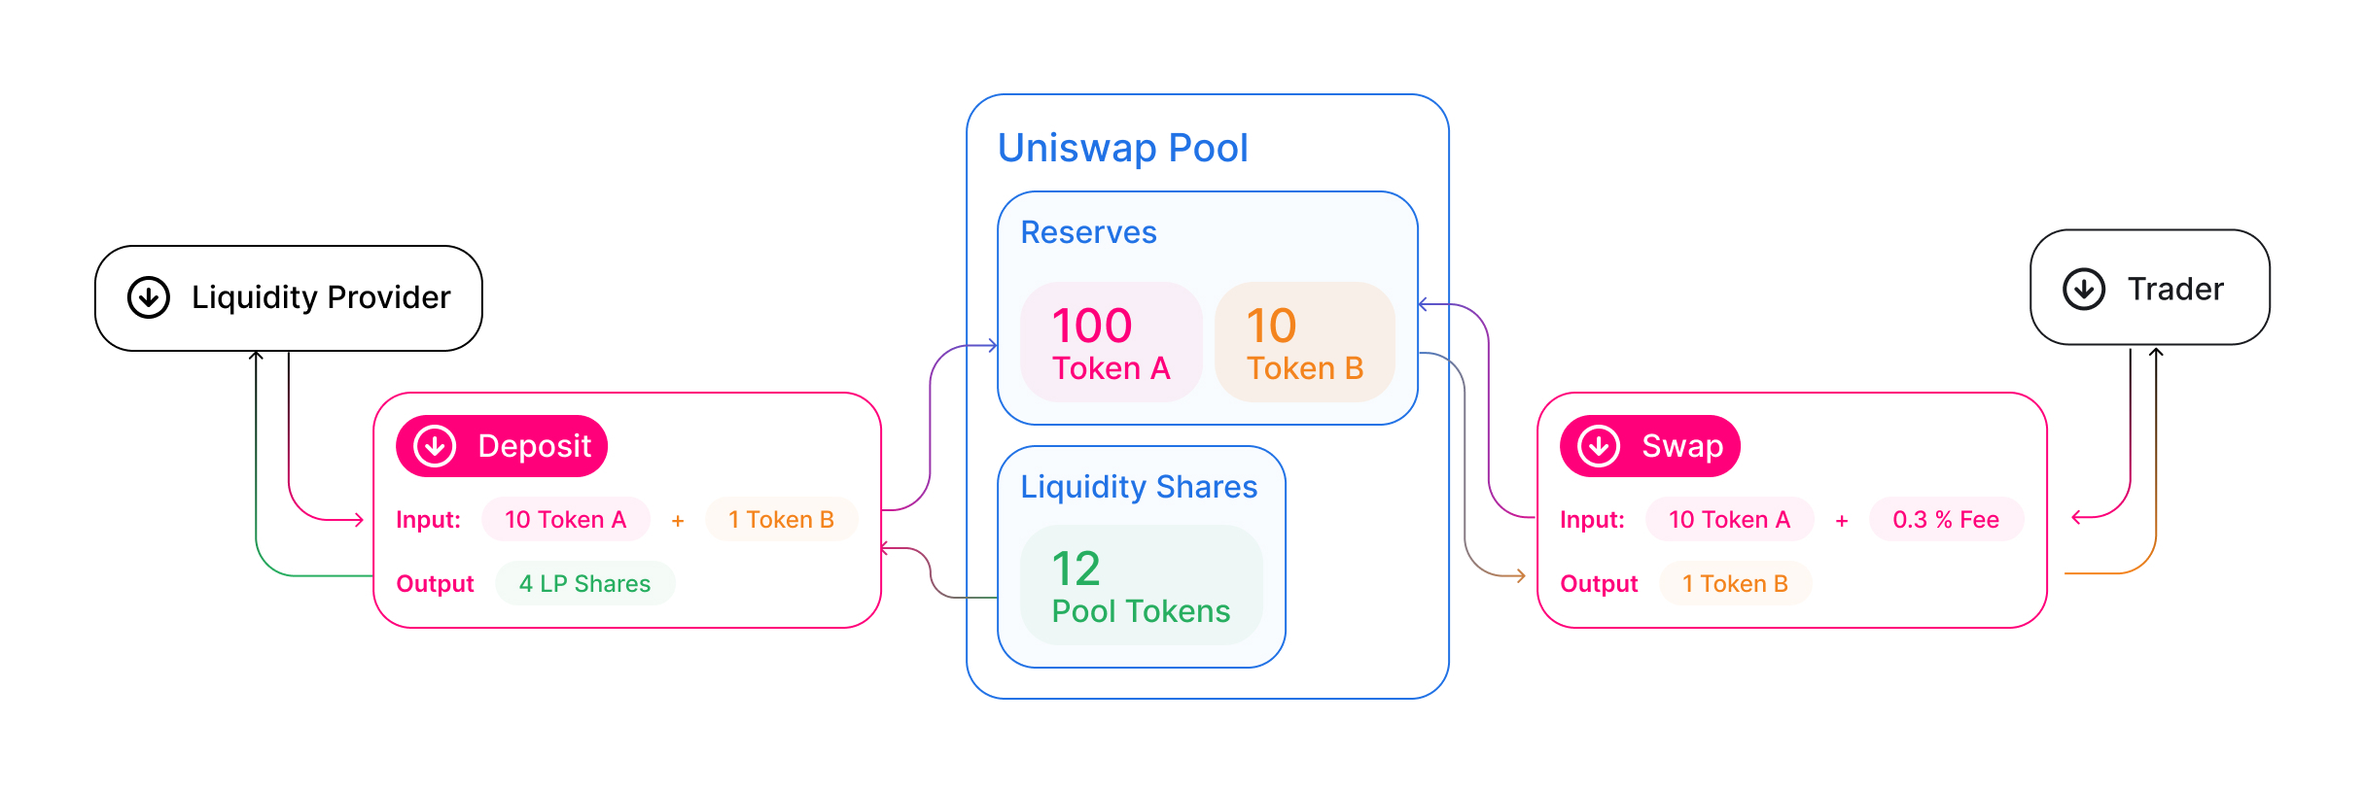
Uniswap
Each Uniswap smart contract, or pair, manages a liquidity pool made up of reserves of two ERC-20 tokens.
Anyone can become a liquidity provider (LP) for a pool by depositing an equivalent value of each underlying token in return for pool tokens. These tokens track pro-rata LP shares of the total reserves, and can be redeemed for the underlying assets at any time.
https://docs.uniswap.org/contracts/v2/concepts/protocol-overview/how-uniswap-works

Slide 86
Exchange… or investing platforms?
Leverage trading means borrowing extra funds to increase a position’s size.
The only difference between crypto leverage trading and leverage in traditional markets is that the former involves cryptocurrencies.
The amount of leverage you can take out is often expressed as a ratio. For example, someone who adds 1:10 leverage to their crypto trade will multiply their position by 10x. Interestingly, some crypto exchanges offer leverage positions of 1:100 (e.g., FTX) or higher!

Slide 87
An example
Suppose you want to take out a 5x leverage position on Bitcoin. First, you'll deposit the required funds onto your crypto exchange and request the loan. If you deposited $5,000 in collateral, a 5x leverage position would give you $25,000.
Remember, with a 5x leverage loan, the price of Bitcoin moves 5x more than on the spot market. So, if Bitcoin's price rose $100, it’ll garner $500 for you. It can also be in the opposite direction. If Bitcoin drops by $100, you’d be down $500. This means Bitcoin doesn’t have to drop to $0 for a leverage trader to lose all their money. If Bitcoin keeps going down, it’ll hit a point where a leverage trader has nothing left in their account. While leverage intensifies a trader’s gains, it also increases the odds that they can lose all their money on a price dip.
While you can close your leverage position anytime, you must be wary of the margin requirement. If Bitcoin's price ever reaches the point where your account position hits the margin threshold, the crypto exchange will liquidate (i.e., sell off) all your funds.

Slide 88
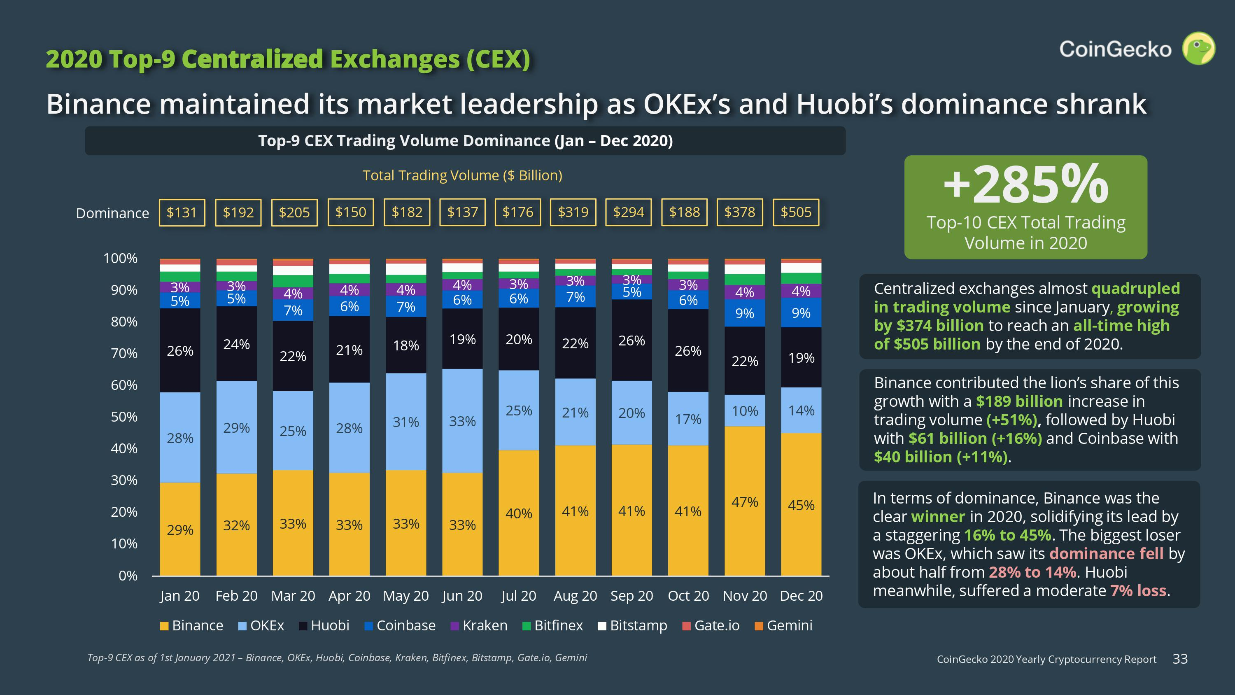
https://www.coingecko.com/en/exchanges

Slide 89
Coingecko Trustscore
In traditional markets, exchanges with high volume equate to high liquidity. However, in crypto markets, exchanges with high volume does not necessarily equate to high liquidity. This is because many of the unregulated exchanges engage manipulative behaviors to inflate their trading volume.
To combat fake exchange volume data, we are launching a new rating algorithm called “Trust Score”
https://blog.coingecko.com/trust-score/
2019
409 Exchanges
12 with TrustScore 10 (maximum)
5 with TrustScore 9
62 with TrustScore greater or equal to 7
2020
421 Exchanges
8 with TrustScore 10 (maximum)
11 with TrustScore 9
66 with TrustScore greater or equal to 7

Slide 90
Quadriga: The cryptocurrency exchange that lost $135m
When the 30-year-old founder of a Canadian cryptocurrency exchange died suddenly, he took the whereabouts of some C$180m ($135m; £105m) in cryptocurrency to his grave. Now, tens of thousands of Quadriga CX users are wondering if they will ever see their funds again.
Quadriga - which had grown to become Canada's largest cryptocurrency exchange - was granted temporary bankruptcy protection in a Canadian court.
The firm said it had spent the weeks since Cotten's death trying desperately to "locate and secure our very significant cryptocurrency reserves".
In court documents, Quadriga says it owes up to 115,000 users an estimated C$250m - about C$70m in hard currency and between C$180m an C$190m in cryptocurrency, based on recent market rates.
It believes - though it's not certain - that the bulk of those millions in reserves was locked away by Cotten in cold storage, which is an offline safeguard against hacking and theft.

Slide 91
Ernst & Young report
Gerald Cotten, the late Quadriga CEO, created a string of accounts on his Canadian cryptocurrency exchange, each under an alias and containing bogus dollar balances, according to Ernst & Young auditors. He then used those accounts, it's claimed, to buy his customers' cryptocurrency with those digitally conjured dollars that didn't actually exist, and then moved the ill-gotten Bitcoin and Ethereum to his accounts at other cryptocurrency trading sites.
A month later, Ernst & Young were able to access five of Quadriga's six offline cryptocurrency wallets that supposedly only Cotten could unlock, and that hopefully still contained customers' coins. All five had been cleaned out by April 2018. The sixth was emptied on December 3, 2018, six days before Cotten was said to have died during his travels in India.

Slide 92
BITGRAIL
Nearly one year after Francesco Firano, the owner and operator of the Bitgrail cryptocurrency exchange, announced that the exchange had lost 17 million NANO (approximately $ 170 million), an Italian Bankruptcy Court and a court-appointed technical expert concluded that Mr. Firano (“The Bomber” as Mr. Firano called himself on social media) was at fault for the loss and is required to return as much of the assets to his customers as possible. The ruling is a landmark decision that sets an important precedent for the protection of cryptocurrency users worldwide.
In its decision, the court concluded that both Bitgrail and Mr. Firano, personally, be declared bankrupt, authorizing seizures of many of Mr. Firano’s personal assets. So far, authorities have seized over $1 million in personal assets, including Mr. Firano’s car. Millions of dollars in cryptocurrency assets have been seized from Bitgrail’s exchange accounts and moved to accounts managed by trustees appointed by the Court.
The Court found that the NANO reported lost by Mr. Firano on February 9, 2018, had actually been removed from the exchange months earlier, between July 2017 and December 2017. The Court criticized Mr. Firano for not immediately taking steps to account for the losses.

Slide 93
As for the mechanics of the loss, the Court concluded that the exchange had failed to implement any meaningful safeguards to ensure the “idempotency” of NANO withdrawals from the Bitgrail exchange.
An idempotent action is an operation that may only be performed once and if performed again will yield the same result.
The failure of Bitgrail to implement idempotent NANO withdrawals permitted users to request a withdrawal using the BitGrail software and under certain circumstances receive the requested amount more than once.
Dec 2020: Investigations suggest that Firano could be the organizer of this fraud.

